Slide 1
Nanotech: The future technology
Gene Anthony Kadano
BSIT – mi121
Information Technology trend
Notes:
If we look up we see technology. If we look to the left we see technology. If we look to the right we see technology. If we look around, we will see technology!

Slide 2
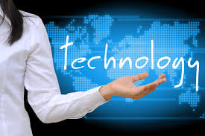
Body of Knowledge
Scientific Method
Application of Science
Group of digital products
Notes:
Technology are used to create tools, processing actions, and extracting of materials.

Slide 3
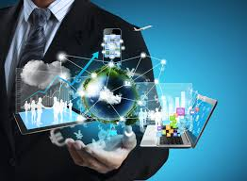
Useoftechnology.com states that:
“We, people, apply technology
in everything we do!”
Technology reduces human effort
Business becomes more competitive
Notes:
To put it simply, technology reduces human effort just like the machines. We uses technology to make life easier and faster and for (second bullet). With this, it only proves that we did not learn technology today but even before the time we know.

Slide 4
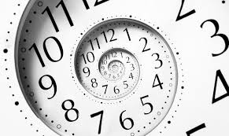
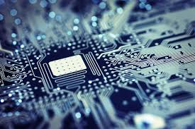
Brief History
Notes:
Many things have helped transformed civilization and shaped life on earth. One of those is technology. However, it is not what is it without its previous forms. So where did it originated?

Slide 5
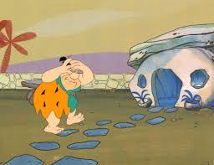
Brief History (cont’d)
Paleolithic Era
Discovered flint stones
Carved stoned are used for cutting,
scraping, and gouging
Stones are carved into spears and arrows
500,000 years later, people have discovered fire.

Slide 6
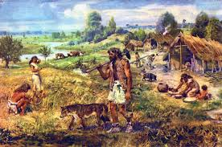
Brief History (cont’d)
Neolithic Era
Pottery are now known from the year of 6500 BC
Melting and casting of metal started during 4000 BC

Slide 7
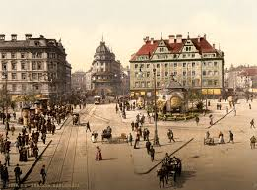
Brief History (cont’d)
19th Century
Lighbulbs
Telephone
Typewriter
Sewing machine
Battery
Morse Code
Others are concepts and principles
Notes:
In the 19th Century, it gave birth to the professional scientists who invented (see bullets). Many have been invented during this time and some are concepts and principles of todays technology

Slide 8
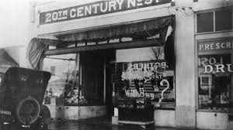
Brief History (cont’d)
20th Century
Video Arcade Games
Radio
Phonograph
Television
Avionics
Notes:
Even though there are lots of technology that has been invented. People continued to innovate.
--- Avionics are the electronic systems used on aircraft, artificial satellites, and spacecraft.

Slide 9
Brief History (cont’d)
21st Century
Smartphones
3D printer
Augmented Reality
Other wearable wireless device
Notes:
Moving towards the 21st century or the modern time. Technology has become more sophisticated and advance like the (bullets)

Slide 10
Nanotech: The future technology
Notes:
With this kind of technologies that people have, what more for the future? Just imagine cars that can travel through land, water, and air or living in world with androids and robots. With so much kind of technology and lots of possibility, NanoTech will be our next future technology.

Slide 11
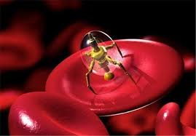
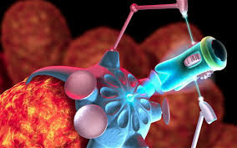
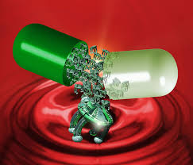
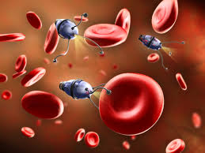
Nanotechnology
Notes:
Nanotechnology is an engineering and technology at a size of 100 nanometer. It is the study and application of extremely small thing which can be used across fields of science. Its concept started at a talk entitled “There’s plenty of room at the bottom” on Dec, 29 1959 by Physicist Richard Feynman. Its goal is to manipulate and control individual atoms and molecules. Thereupon, just imagine the possible applications of nanotech.

Slide 12
Nanotechnology application
Medicine
Electricity and IT Technology
Environmental Remediation
Food
Fabric
Others
Notes:
Hearing the phrase “With great power comes great responsibility” from the movie spiderman. Nanotech, with the proper side of research and implementation, we could still save our dying planet and save billions of life. With this kind of potential, here are some of the application nanotechnology can be used.

Slide 13
Nanotechnology: Medicine
Research on the use of nanorobotics. Sometimes called nanomedicine.
Research on nanoparticles, involves delivery of drugs to a specific type of cell (e.g. cancer cell)
Prevents atherosclerosis during the first diagnosis using nanotech.
Notes:
(Bullet 1) Nanomedicine are robots working at a cellular level in repairing damage cells.
(Bullet 2) Nanoparticle are engineered to be attracted to diseased cells and delivers a drug, or direct treating of cells. It reduces the damaging of healthy cells.
(Bullet 3) Atherosclerosis is a plaque building up in the arteries.

Slide 14
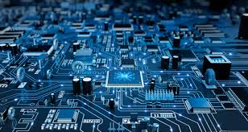
Nanotechnology: electronic and IT technology
Nanotech on MRAM (Magnetoresistive Random Access Memory)
MRAM uses magnetic charge in storing data bits
It can retain all data stored even if power is cut
MRAM can prevent losing data during a system crash or power failure
Notes:
Almost every electronics consumes huge amount of power. Harnessing the power of nanotech, it will greatly improve the capabilities of each device while reducing the power consumption and also its weights

Slide 15
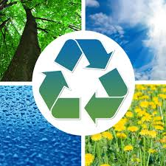
Nanotechnology: Environmental Remediation
Water filtration and purification in polluted water source
Removing of arsenic or carbon tetrachloride with a magnetic reaction between ultrasmall pecks of rust
Notes:
Nanotech can be applied to almost everything. From medicine, machinery up until to the eco-friendly application of it. An example of nanotech in the environment are: (see bullets)

Slide 16
Nanotechnology Benefits
Advanced Manufacturing
Agriculture
Automotive
Energy/Power
Environment
Healthcare
Notes:
Advanced Manufacturing – Higher power output
Agriculture - higher crop yield, improved water management, and reduced pesticide use
Automotive – Lower CO2 emission, lighter materials, and runs on less fuel intake
Energy/Power – Produces newer materials for energy harvesting and storage
Environment – Provides air and water filtration, waste and water treatment
Healthcare – research on nanomedicine, and medical doctors will be able to provide better health care

Slide 17
Nanotechnology Ethical issues
Lab safety
Environmental consequence to research
Commercial fair dealing
Medical technologies
Security and privacy implications
Notes:
Lab safety – gives consideration for the health of the researchers, their well-being, and reporting of unsafe testing
Environmental consequence to research – How would researchers minimize and reduce hazardous substance in the nanowaste
Commercial fair dealing – Prevents the confidentiality and secrecy of the project
Medical technologies – tackles about the human enhancement and genetic modifications
Security and privacy implication – gives concern on the safety and privacy of the person using the nanotech

Slide 18
Conclusion
Nanotechnology is like a coin. It only had two sides.
One side could cause havoc and fear to the public. It could take millions, not just thousand, but millions of lives when not used properly.
The second side is that it could give life to others, enrich the country and its economy, save the planet, and give a brighter future for the next generations to come.

